Slide 1
TMC New System: Structure and Development Technologies
Yanxiang Du
Master Thesis Worker

Slide 2
这一页列一下TMC 的模块
Master Data Maintenance & Upload Entry :Submit Matrix Upload OTH data Upload CRP data
Preparation AND Adjustment Layers: Preparation Raw Layer, Prepared Layer, Adjustment Layer
Machine Line Split: Total Market Calculation, Restatement
Validation Layer: TMC Validation Report
然后每一步简单介绍一下是干什么的

Slide 3
这一页介绍一下开发工具
前端：React + TypeScript + Vite前端部署：Vercel
后端：Python + FastAPI后端运行：Google Cloud Run
数据库：PostgreSQL数据库
托管：Google Cloud SQL
容器化：Docker镜像仓库：Google Artifact Registry
自动部署：GitHub Actions
云端身份认证：Workload Identity Federation + GCP Service Account
跨域配置：CORS
代码托管：GitHub
部署地址：https://thesis-rust-five.vercel.app/
GitHub地址：https://github.com/YanxiangDu2023/thesis

Slide 4
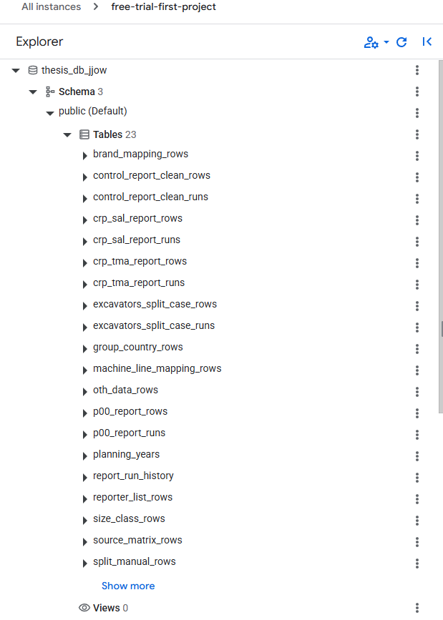
这一页介绍一下有哪些table

Slide 5
这一页介绍一下前后端怎么交互的

Slide 6
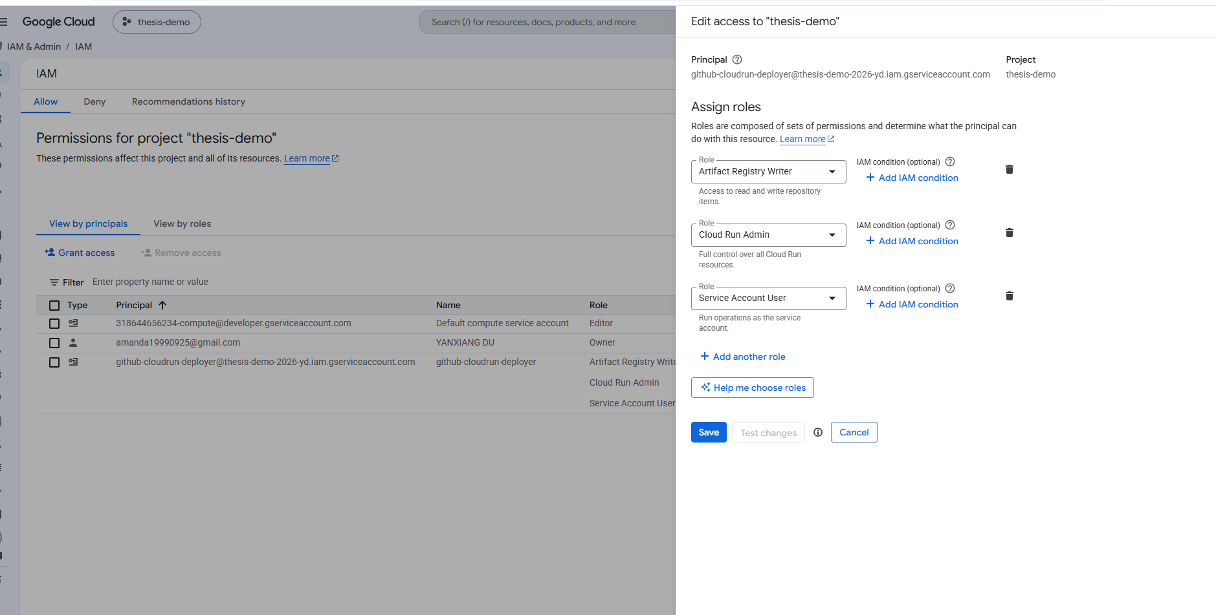
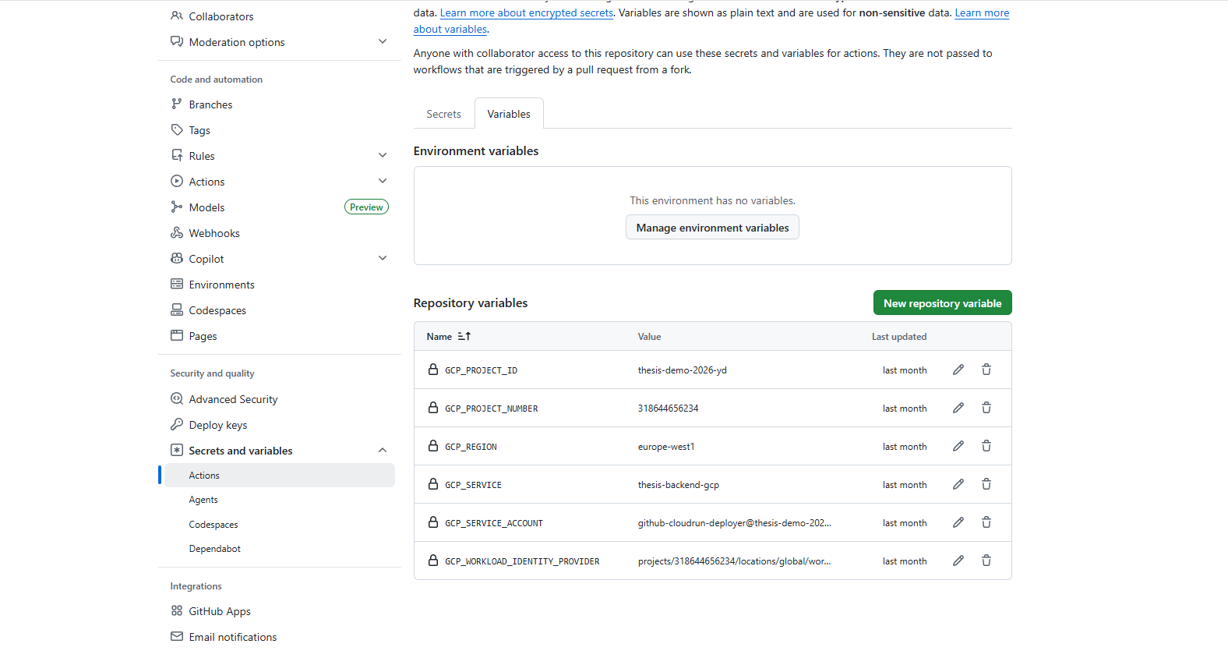
这一页介绍一下怎么部署的，GitHub 怎么去找google cloud，怎么自动部署的

Slide 7
这一页介绍一下google cloud run的费用问题
待完成：validation/non reporter brand 如何处理

Slide 8

THANKS
Volvo Construction Equipment | Strategy & Business development| Madeleine Broberg| Internal
2026-06-14

Slide 9

MC Matrixes
Size class flag
Reporters
Source matrix
Bulkchart + Participation history
TM North America
TM Hargrove worldwide
TM European
Country groupings
ICEMA
Manual corrections/ CCMA
TM shipments
Brands
Global BI | TMC 20251 Market Share & Competitor evolution| Madeleine Broberg | Confidential - for internal use only
11 November 2022

